Slide 1
8th Grade Science Standard Review
S8P1 Students will examine the scientific view of the nature of matter.
S8P2 Students will be familiar with the forms and transformations of energy.
S8P3 Students will investigate relationship between force, mass, and the motion of objects.
S8P4 Students will explore the wave nature of sound and electromagnetic radiation.
S8P5 Students will recognize characteristics of gravity, electricity, and magnetism as major kinds of forces in nature.

Slide 2
1. How are atoms and molecules different?
A. Atoms are comprised of more than one element and molecules are comprised of only one element.
B. Atoms are comprised of only one element and molecules are comprised of more than one element.
C. Both atoms and molecules are comprised of only one element.
D. Both atoms and molecules are comprised of more than one element.

Slide 3
2. Use the above picture to fill in the blanks for the following statement. Two of the element sodium combine with one of the element chlorine to form the sodium chloride.
A. atoms; atom; compound
B. atoms; molecule; compound
C. molecules; molecule; compound
D. compounds; atom; molecule

Slide 4
3. What defines a mixture?
A. created through a chemical reaction
B. described by a chemical formula
C. cannot be broken down into simpler substances
D. can be broken down into its basic substances through physical means

Slide 5
4. The process that enables you to hear the sound of a drum around the corner is
A. diffraction.
B. polarization.
C. refraction.
D. absorption.

Slide 6
5. Which of the following statements about animals used in research is true?
A. There are no laws that govern how animals in research facilities must be treated.
B. More animals are used in research today than 20 twenty years ago.
C. Animals are unnecessary in scientific research because alternatives are available.
D. Federal laws specify that animals used in research must receive humane care and treatment.

Slide 7
6. Stephen measured the length of a section of a river as 182 m. Convert this measurement to centimeters.
A. 182 cm
B. 1,820 cm
C. 18,200 cm
D. 182, 000 cm

Slide 8
7. In which of the following phases of matter do molecules have the lowest amount of energy?
A. solid
B. liquid
C. gel
D. gas

Slide 9
8. Calculate the density of an object that has a mass of 10g and a volume of 5cm³. Remember: Density=M/V
A. 5 g/cm³
B. 5 g
C. 2 g
D. 2 g/cm³

Slide 10
9. What is the arrow pointing at?
A. Atomic Number
B. Atomic Mass
C. Number of electrons
D. Element symbol

Slide 11
11. What is not one of the 3 elemental families on the periodic table?
A. metal
B. metalloid
C. nonmetal
D. liquid

Slide 12
12. A scientist gathered data involving the number of times different birds located food in a maze. In which set of numbers are the mean, median, and mode all equal?
A. {2,4,6,6,8,10}
B. {2,6,6,8,10}.
C. {2,2, 4,8,10,10}.
D. {2,4,6,8,10}.

Slide 13
13. Which of the following must be true if an object is accelerating?
A. Friction is not acting on the object.
B. The object no longer has inertia.
C. An unbalanced force is acting on the object.
D. Balanced forces are acting on the object.

Slide 14
14. In a chemical reaction, the total mass of the reactants is 10.0 grams. The total mass of the products must be:
A. more than 10.0 grams.
B. exactly 20.0 grams.
C. exactly 10.0 grams.
D. less than 10.0 grams.

Slide 15
15. Which characteristics of light waves determines its color?
A. Amplitude
B. Wavelength
C. Speed
D. Medium

Slide 16
16. SEVERAL DISK MAGNETS ARE PLACED NEAR A WIRE. When a current is allowed to flow, the magnets exerts a force on the wire. Why is this true?
A. magnetism flows from the magnets to the wire.
B. Charges leak from the wire to the magnets.
C. The poles of the magnets are reversed by the wire.
D. The current is the wire produces a magnetic field.

Slide 17
17. Precision can be described as repeatable whereas accuracy can be described as _________.
A. Correct.
B. Wrong.
C. Approximate.
D. Expected.

Slide 18
18. Water is boiled and steam is produced. This is a physical change because the water particles
A. are still water particles.
B. have turned into something new.
C. have been destroyed.
D. have reacted with each other

Slide 19
19. Hydroelectric power plants use the energy in moving water to turn the blades of a turbine. Wind power plants use the energy in wind to turn the blades of a turbine. In both cases, the form of energy involved in the movement of the turbine blades is
A. electric energy
B. thermal energy
C. magnetism
D. mechanical energy

Slide 20
20. Calculate the momentum of a 14 kg bicycle traveling north at 2 m/s. Remember: P=MV
A. 28 kg m/s North
B. 28 kg m/s
C. 7 kg m/s North
D. 7 kg m/s

Slide 21
21. If you could account for all the energy input at the beginning of a chemical process in a closed system,
A. You would be expect a lot of energy to be gone at the end.
B. It would equal the amount of energy present in all forms at the end of the process.
C. It would not change form or amount throughout the process.
D. It would double by the end of the process.

Slide 22
22. Water can be described in a variety of ways. Which of the following statements describes a chemical property of water?
A. Ice melts into liquid water at a temperature of 0 degrees Celsius.
B. At room temperature, water has an approximate density of 1 g/mL.
C. Water is a generally unreactive compound.
D. Liquid water vaporizes into steam at a temperature of 100 degrees Celsius.

Slide 23
23. The law of _______ of energy states that energy cannot be created or destroyed.
A. transformation
B. conservation
C. absorption
D. stability

Slide 24
24. In an ecosystem, only about 10 percent of the energy at each trophic level reaches the next level. What happens to the rest of the energy?
A. It is used up and later replaced in nature.
B. It is destroyed because it is not needed.
C. It is converted to some other form, such as heat.
D. It is changed into some type of matter such as soil.

Slide 25
25. A stone held above the ground has potential energy. When the stone is dropped, potential energy is converted to _________ energy.
A. chemical
B. electrical
C. kinetic
D. thermal

Slide 26
26. How does the gravitational pull between 2 objects change when the distance between the objects is doubled?
A. The force is multiplied by 2
B. The force is multiplied by 4
C. The force is divided by 2
D. The force is divided by 4

Slide 27
27. Scientists have designed solar cells to trap solar energy and convert it to _____ energy.
A. hydroelectric
B. wind
C. chemical
D. electrical

Slide 28
28. The energy directly associated with the motion of charged particles is
A. Electrical energy
B. Heat energy
C. Mechanical energy
D. Light energy

Slide 29
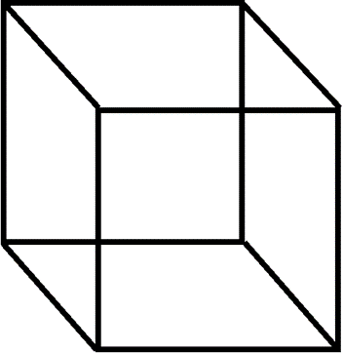
29. Calculate the volume of a cube.
3 cm
A. 8 cm³
B. 6 cm³
C. 9 cm³
D. 18 cm³
2 cm
3 cm

Slide 30
30. Which of the following CANNOT overcome an object’s inertia?
A. An unbalanced forced
B. A zero net force
C. Gravity
D. Friction

Slide 31
31. An object is placed on the side of a translucent material. How does the object appear to the person on the other side
A. The object is seen clearly.
B. The person sees the object, but it appears fuzzy.
C. The person sees the object, but only in black and white.
D. The person does not see the object at all

Slide 32
32. Which of the following is an example of heat transfer through conduction?
A. hot air rising inside a house
B. a pan on the stove getting hot
C. the Sun drying clothes hanging outside
D. a microwave warming a cup of water

Slide 33
33. Light can be separated into the colors of the visible spectrum when
A. The light is reflected off a smooth surface.
B. The light is diffracted off a rough surface.
C. The light is refracted by a prism.
D. The light is refracted by a mirror.

Slide 34
34. When hot and cold air meet, the hot air rises to the top. Which process causes the hot air to rise?
A. induction
B. convection
C. radiation
D. conduction

Slide 35
35. Which of these devices uses lenses and a mirror to focus the light from objects that are far away?
A. Microscope
B. Prism
C. Camera
D. Telescope

Slide 36
36. When kinetic energy changes to potential energy,
A. The total amount of energy stays the same
B. The total amount of energy increases.
C. The total amount of energy decreases.
D. The total amount of matter decreases.

Slide 37
37.Which of the following statements about radiation is true?
A. Radiation is the only form of heat transfer that is not experienced on Earth.
B. Radiation is the only form of heat transfer that is unable to travel through the vacuum of space.
C. Radiation is the only form of heat transfer that is experienced on Earth.
D. Radiation is the only form of heat transfer that can travel through the vacuum of space.

Slide 38
38. Which of the following is an example of acceleration? I. A car speeds up. II. A car slows down. III. A car travels in a straight line at a constant speed. IV. A car travels at a constant speed and turns left.
A. I and IV only
B. III only
C. I, II, and IV only
D. I, II, III, and IV

Slide 39
39. In which molecule are all the atoms the same?
A. CO₂
B. CCl₄
C. CO
D. Cl₂

Slide 40
40. Calculate the speed of a runner that travels 75 m in 3 s. Remember: Speed = D/t
A. 78 m/s
B. 225 m/s
C. 50 m/s
D. 25 m/s

Slide 41
41. Mass and distance between 2 objects affect
A. Friction between the objects.
B. Magnetic attraction between the objects.
C. Gravitational attraction between the objects.
D. Electrical attraction between the objects

Slide 42
42. Which of the following determine an object's velocity?
A. speed and mass
B. speed and direction
C. speed, direction, and acceleration
D. direction and acceleration

Slide 43
43. A group of lights are connected in a parallel circuit. One of the bulbs is removed. The rest of the lights will
A. Start blinking
B. Get dimmer
C. Go out
D. Stay lit

Slide 44
44. Jennifer stands on one side of a filing cabinet and pushes with a force of 60 N. If Nathan wants to help Jennifer demonstrate balanced forces, what does he need to do?
A. cause the cabinet to move
B. stand on the opposite side of the cabinet and push with a force of 60 N toward Jennifer
C. stand on the opposite side of the cabinet and push with a force of 120 N toward Jennifer
D. stand on the same side of the cabinet and push with a force of 60 N in the same direction as Jennifer

Slide 45
45. The transfer of heat by collision between at atoms is
A. Conduction.
B. Convection
C. Radiation.
D. Thermal energy

Slide 46
46. Newton's first law states that an object in motion will stay in motion unless acted upon by an unbalanced force. If you roll a ball across the floor, you put the ball in motion, but after time, the ball stops. Does this violate Newton's first law?
A. No, because the ball is acted upon by the unbalanced force of friction.
B. Yes, because the unbalanced force of friction should have kept the ball moving.
C. Yes, because the ball should have continued rolling forever.
D. No, because Newton's laws are really only theories.

Slide 47
47. What happens to a sound when it travels from air to water?
A. Its loudness increases.
B. Its loudness decreases.
C. Its speed increases.
D. Its speed decreases.

Slide 48
48. Last-minute Louis frantically tried to finish his homework while his mom drove him to school. He placed his book on his lap and was reaching for a pencil when his mom suddenly slammed on the brakes. Although Louis stayed buckled in his seat, his book flew forward and crashed into the front windshield. Which of the following was most responsible for the book flying forward?
A. inertia
B. gravity
C. friction
D. displacement

Slide 49
49. Which of these statements about elements in the same column of the periodic table is true?
A. Elements in the same column have the same number of energy levels.
B. Elements in the same column have similar properties.
C. Elements in the same column have the same number of electrons.
D. Elements in the same column are equally reactive

Slide 50
50. Calculate the acceleration of a box when the net force on the box is 1.0 N and the mass of the box is 4.0 kg. Remember: A = Fnet/M
A. 4.0 m/s
B. 4.0 m/s²
C. 0.25 m/s
D. 0.25 m/s²

Slide 51
51. In solids, heat transfer occurs by
A. Convection
B. Conduction
C. Radiation
D. Insulation

Slide 52
52. What is the resistance that one surface or object encounters when moving over another.
A. medium
B. friction
C. waves
D. gravity

Slide 53
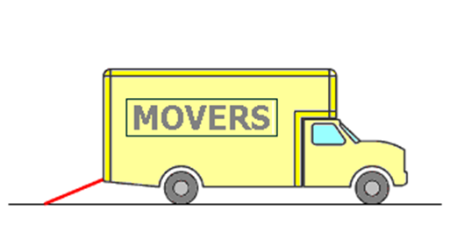
53. In the drawing below, what type of simple machine is shown in red?
A. wheel and axle
B. screw
C. lever
D. inclined plane

Slide 54
54. How are mechanical and electromagnetic waves different?
A. mechanical waves do NOT require a medium to travel and electromagnetic waves do.
B. mechanical waves do require a medium to travel and electromagnetic waves do NOT.
C. both mechanical waves and electromagnetic waves do NOT require a medium to travel.
D. none of these are true.

Slide 55
55. Which of the following is an example of reflection?
A. a large water wave forming from the combination of two smaller waves
B. light from a flashlight bouncing back after striking a mirror
C. a flower stem appearing to be broken when partially submerged in water
D. compact discs displaying a rainbow pattern when placed under lights

Slide 56
56. What is the voltage of a cell-phone charger that has a current of 14 amperes and a resistance of 2 ohms? Remember: Voltage = Current x Resistance
A. 7 volts
B. 24 volts
C. 28 volts
D. 32 volts

Slide 57
57. If a black car and a white car are left in the Sun, the black car will tend to be hotter. This is because the black car's surface will _______ more light energy than a white car.
A. absorb
B. refract
C. conduct
D. reflect

Slide 58
58. Is ordinary window glass transparent, opaque or translucent?
A. transparent
B. opaque
C. translucent
D. none of the above

Slide 59
59. The material in which a wave travels is what?
A. medium
B. friction
C. waves
D. gravity

Slide 60
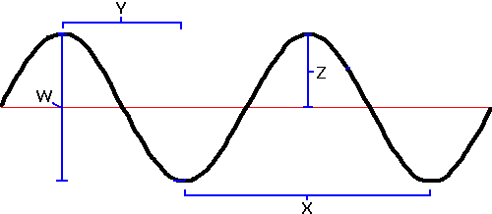
60. Which letter corresponds to the wavelength of the wave?
A. W
B. X
C. Z
D. Y

Slide 61
61. What is the acceleration of a car that is traveling at a constant speed of 24 m/s for 2 s? Remember: A = (Sf-Si) / T
A. 48 m/s²
B. 12 m/s²
C. 44 m/s²
D. 0 m/s²

Slide 62
62. Waves transport _______ over distances.
A. liquids
B. solids
C. gases
D. energy

Slide 63
63. What happens to the gravitational force between two objects as the bodies become farther apart from each other?
A. The gravitational force stays the same.
B. The gravitational force begins to repel the objects.
C. The gravitational force decreases.
D. The gravitational force increases

Slide 64
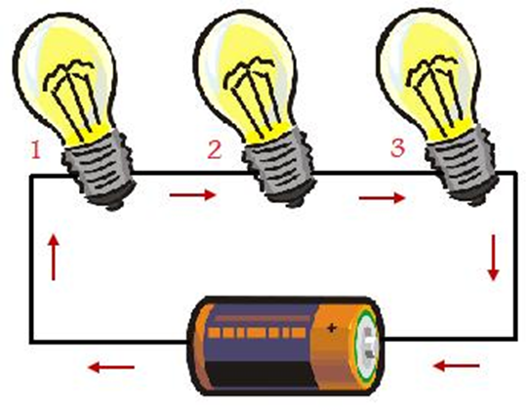
64. Determine if the following picture is a series circuit or a parallel circuit.
A. series circuit
B. parallel circuit
C. both
D. neither

Slide 65
65. Is your body an insulator or a conductor?
A. insulator
B. conductor
C. both
D. neither

Slide 66
66. What is the velocity of a car that is traveling 20 m North for 4 s? Remember: Speed = D/t
A. 80 m/s²
B. 80 m/s² North
C. 5 m/s²
D. 5 m/s² North

Slide 67
67. Which of the following objects exerts gravitational force? I. the Sun II. the Earth III. the Moon IV. a basketball V. an apple
A. I and II only
B. I, II, III, IV and V
C. I, II, and III only
D. IV and V only

Slide 68
68. When does a static charge happen?
A. When protons build up or are transferred from one object to another
B. When electrons build up or are transferred from one object to another
C. When protons are created.
D. When electrons are created.

Slide 69
69. In an electromagnetic wave, the charged particles make what type of fields?
A. electric field
B. magnetic field
C. both
D. neither

Slide 70
70. What is the relationship between electricity and magnetism?
A. An electric current creates a magnetic field, and a moving magnet creates a current.
B. A moving magnet creates a magnetic field, and an electric current makes electrons stand still.
C. A moving magnet creates a current, and a still magnet creates a current.
D. An electric current creates a magnetic field, and electrons that are moving create a magnetic field.

Slide 71
71. Convert 12˚C into Kelvin. Remember: k = c + 273
A. 285 K
B. 295 K
C. 305 K
D. 315 K

Slide 72
72. Which of these is an advantage of parallel circuits over series circuits?
A. If one receiver stops the energy flow, the other receivers can still work.
B. If the battery dies, energy can still flow through the receivers.
C. The voltage is stronger from the battery.
D. The current is stronger through the receivers

Slide 73
73. Fran is conducting an experiment to determine how light affects the growth of bread mold. She is trying to decide the best way to conduct her experiment in order to collect meaningful data. Which of the following experiments would help Fran collect the best data?
A. Place the main ingredients of bread in a lighted area and the same amount of the ingredients in a darkened area, and then observe the rate of mold growth over time.
B. Place one sample of white bread and one sample of whole wheat bread in a lighted area, and then observe the rate of mold growth over time.
C. Place one piece of bread in a lighted area and one piece of bread in a darkened area, and then observe the rate of mold growth over time.
D. Place a sample of bread mold in a moist, dark area and record its rate of growth over time.

Slide 74
74. Aristotle, the ancient Greek philosopher, thought that heavy objects fall to Earth faster than lighter objects. How could Aristotle's hypothesis be supported or disproved?
A. Find out if there is a consensus of opinion among leading scientists.
B. Have supporters of Aristotle's idea debate people who disagree with Aristotle's idea.
C. Drop two balls with different weights and observe which ball hits the ground first.
D. There is no way to discover whether a hypothesis is not correct.

Slide 75
75. What is the SI unit for measuring mass?
A. grams
B. meters
C. liters
D. kelvin

Slide 76
76. Fill in the blank with the appropriate number in order to balance the following chemical equation. 4Fe + ___O2 → 2Fe2 O3
A. 6
B. 4
C. 3
D. 2

Slide 77
77. What score will be my lowest on the science crct?
A. 850
B. 850
C. 850
D. 850

